Slide 1
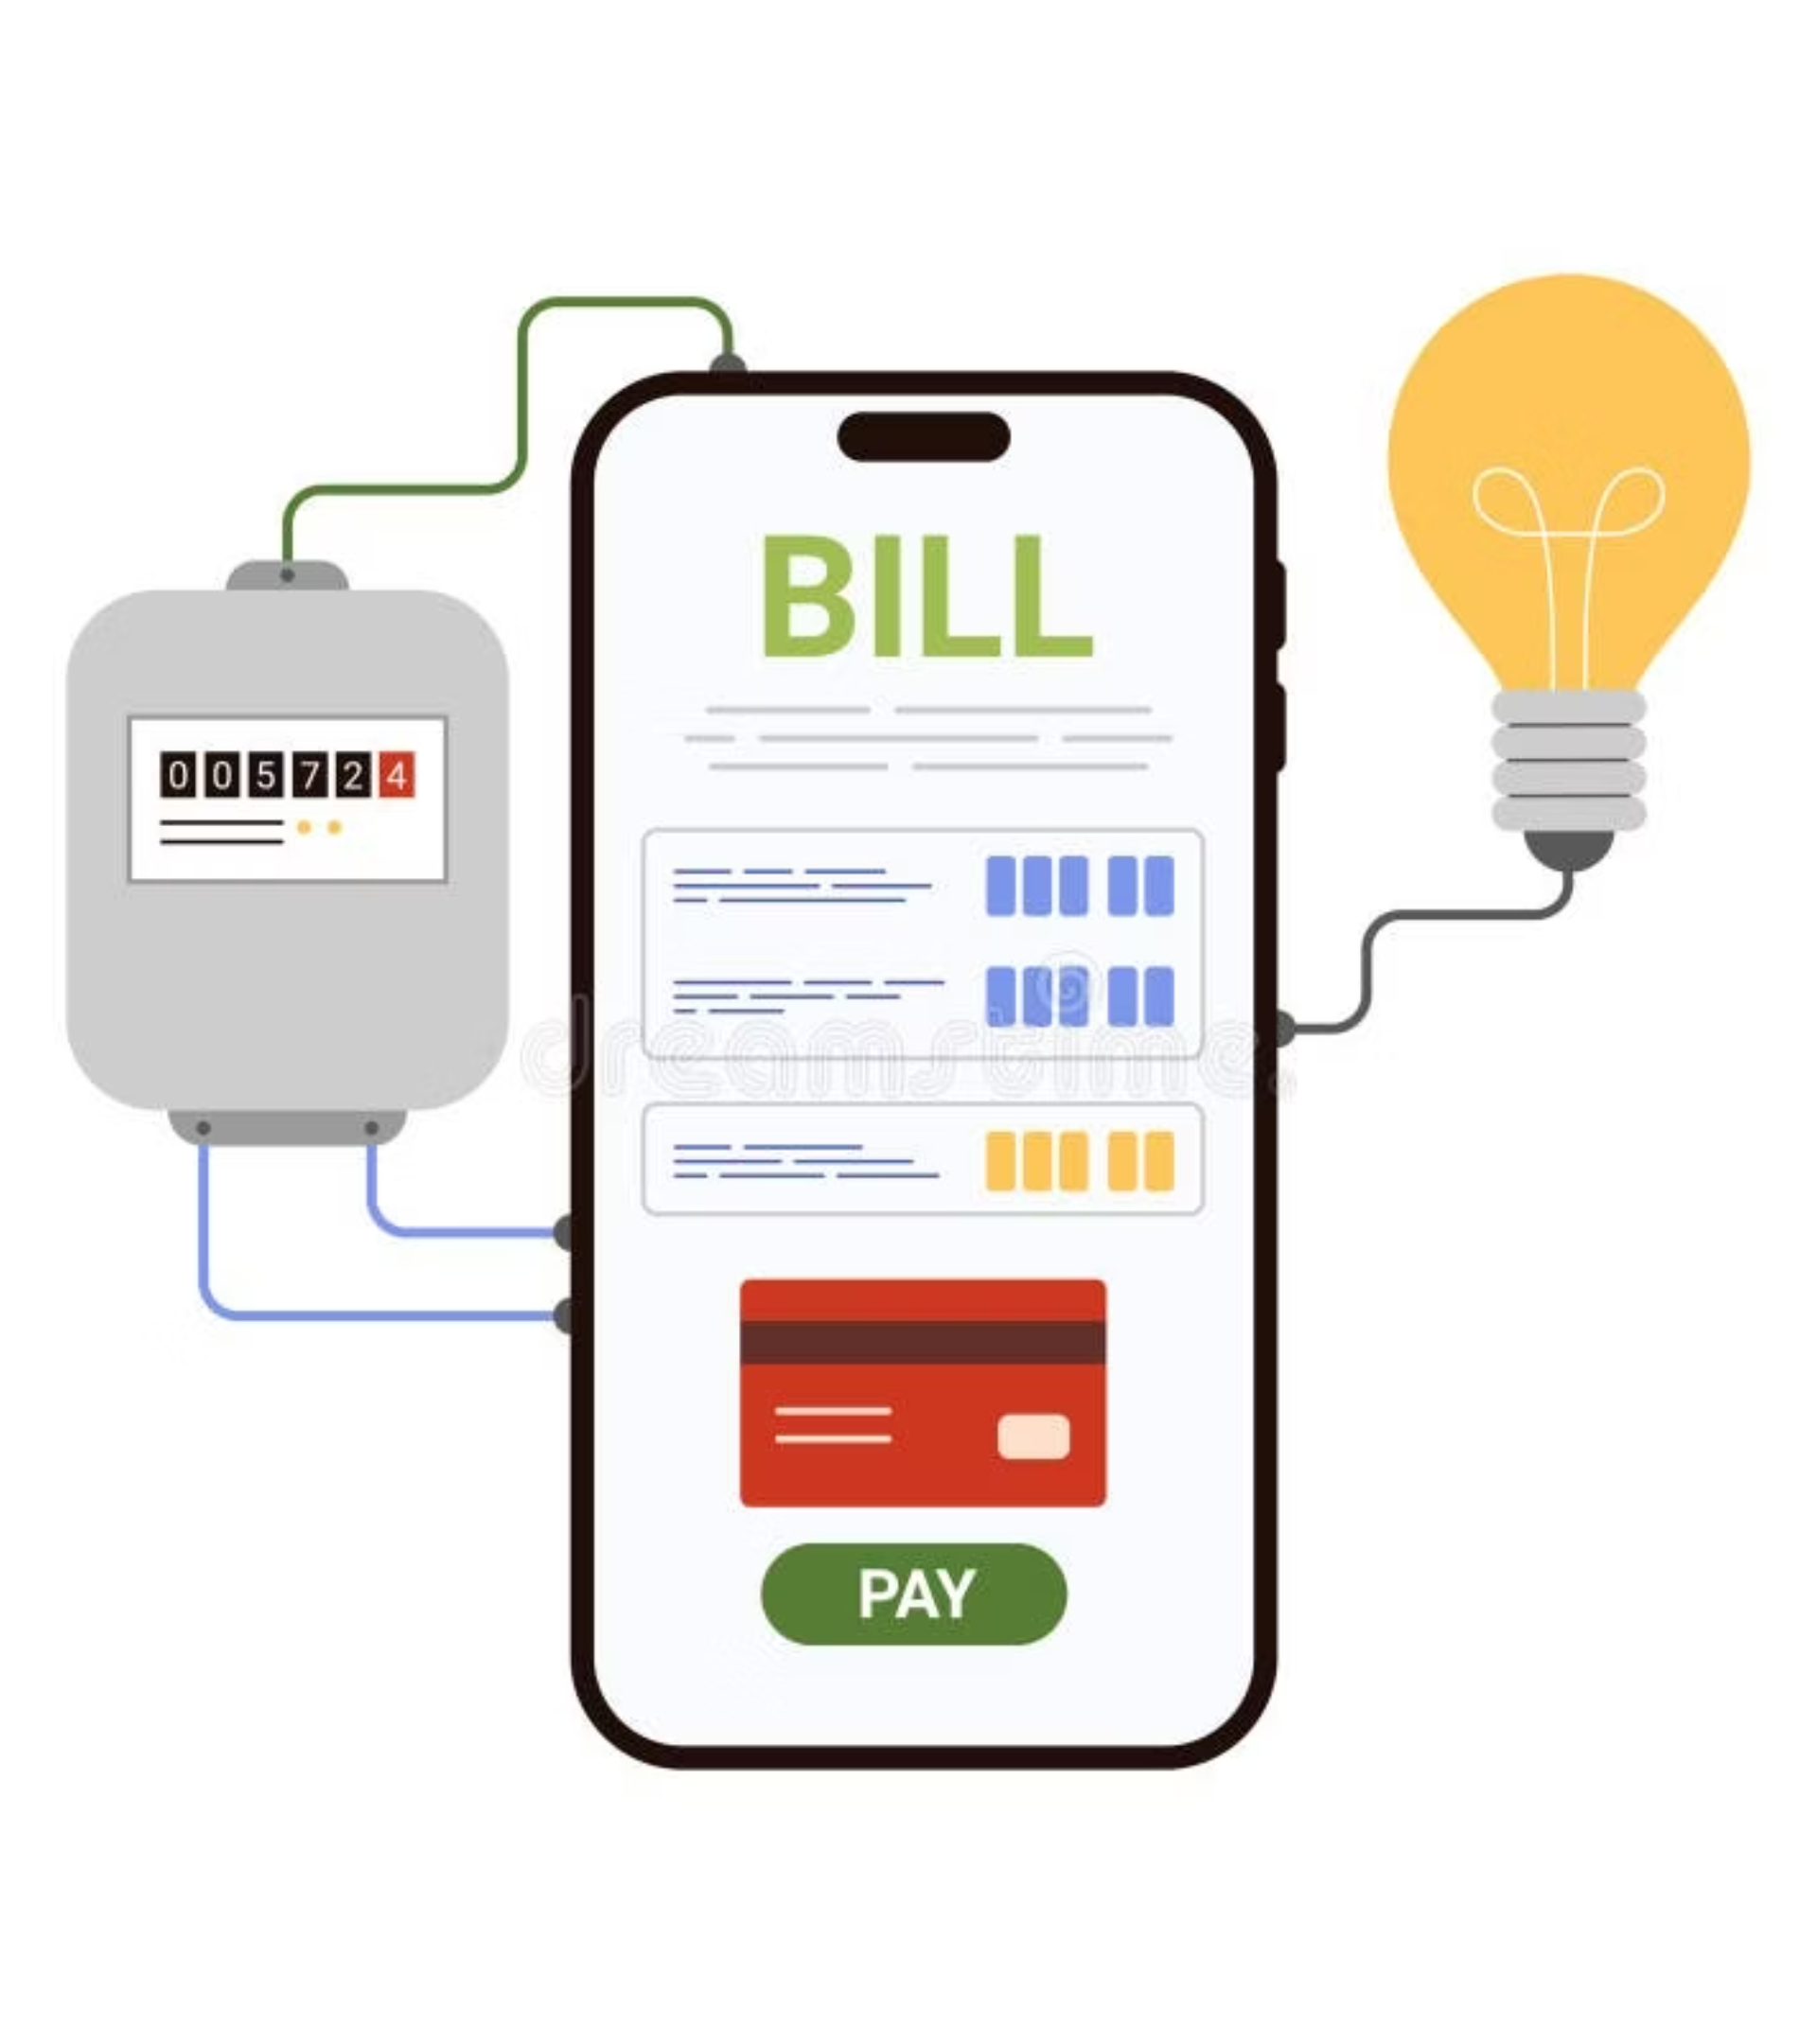
Electricity Billing System
Presented By: Anshu Hada
CSIT 4TH SEM, Section: A

Slide 2
Electricity Billing System
Traditional electricity billing is often plagued by manual processes, leading to delays, errors, and significant operational costs. Our new system addresses these challenges head-on by streamlining operations and enhancing user satisfaction.
Efficiency Boost
1
Automates billing cycles, significantly reducing manual effort and processing time.
Enhanced Accuracy
2
Minimizes human error, ensuring precise bill calculations and customer data integrity.
User-Friendly Experience
3
Intuitive interfaces for both administrators and customers, simplifying interactions .

Slide 3
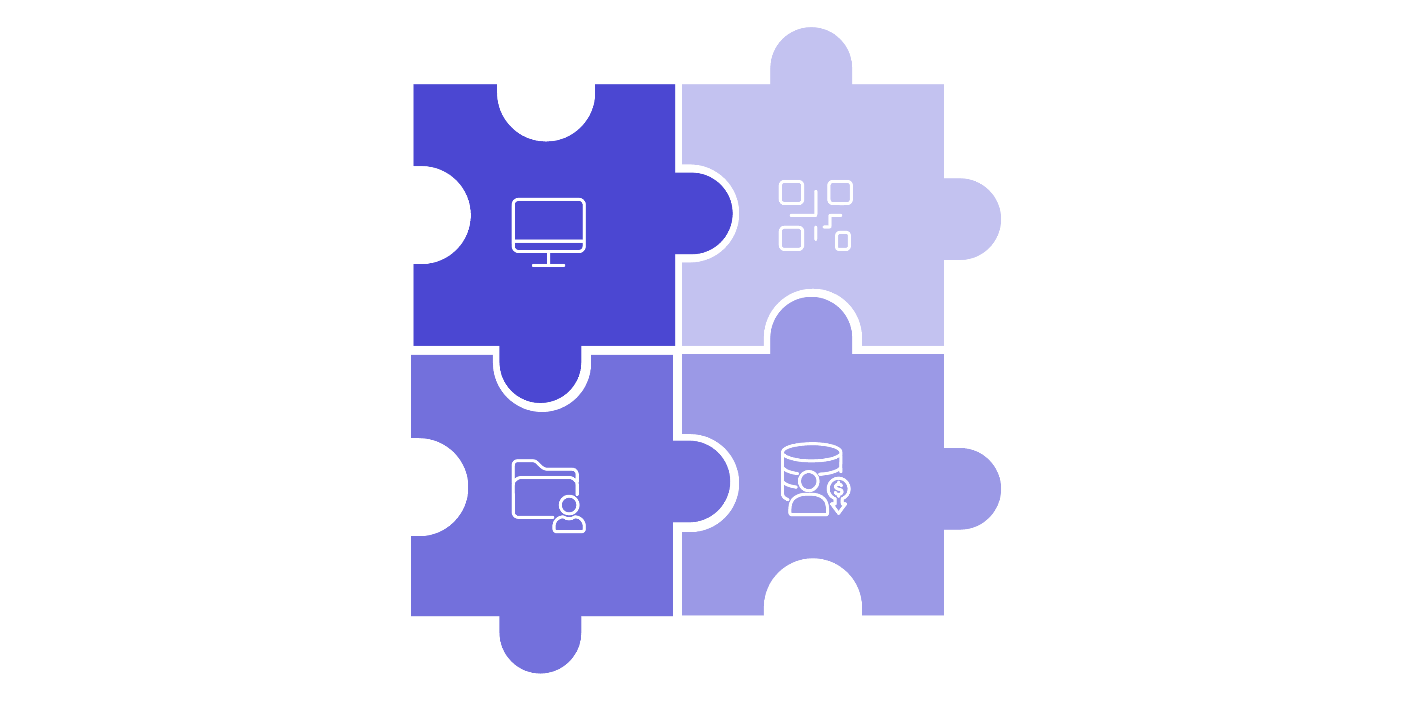




System Architecture
Our Electricity Billing System is engineered for robustness and scalability, leveraging proven technologies to deliver reliable performance and seamless integration.
Java Swing
DAO Layer
MySQL
JDBC Connectivity

Slide 4
Key Features
Admin Functions
User Functions
Comprehensive customer management (add, update, search , view and delete)
Secure, personalized login access
Instant access to current and historical bill details
Effortless bill generation and management
Convenient online bill payment options
Full visibility into customer accounts and payment history
Personalized dashboard for usage tracking
Robust user role and access control

Slide 5
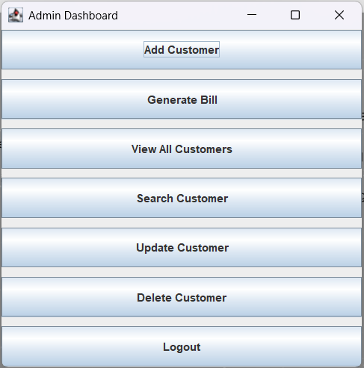
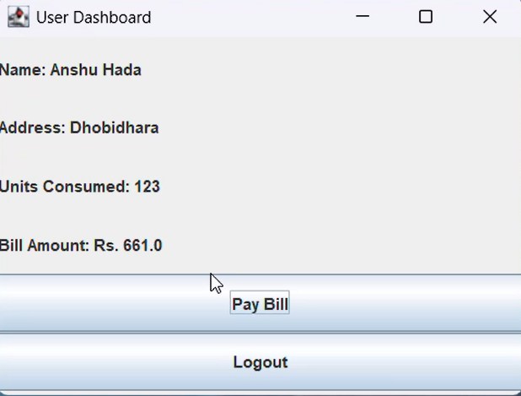

Slide 6

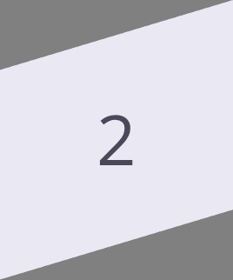
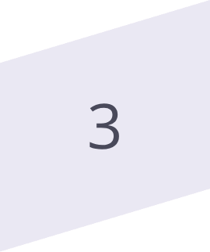
Conclusion:
The Electricity Billing System is more than just a software solution; it's a strategic asset for providers and a convenience for customers, designed for the future of energy management.
Streamlined Operations
Automated processes lead to significant time and cost savings for electricity providers.
Enhanced Customer Experience
Secure and user-friendly access empowers customers with better control over their billing.
Scalability & Reliability
Built on robust technologies, the system is ready to grow with evolving demands and maintain high uptime.

Slide 7
THANK YOU!

